Slide 1
A Twitter-based Software Vulnerability Alert
Framework using Natural Language Processing
Individual Task: 1
Group: 35
Submitted By: Kaji Sajjad Hossain
ID: 20101321
Section: 1
Submitted To: Annajiat Alim Rasel
RA: Sabbir and Mehnaz

Slide 2
Outline
● INTRODUCTION
● MOTIVATION
● CONTRIBUTION
● METHODOLOGIES AND EXPERIMENTS
● RESULT
● LIMITATIONS
● FUTURE WORK
● CONCLUSION

Slide 3
Introduction
The paper discusses the increasing cyber threats and the need for effective cybersecurity measures in modern organizations.
It introduces Twitter as a valuable source of publicly available data for detecting security vulnerabilities.

Slide 4
Motivation
Organizations use diverse software with potential security vulnerabilities.
Unofficial information about these vulnerabilities might be available on Twitter, posing risks if misused by attackers.

Slide 5
Contribution
Introduction of a Natural Language Processing (NLP)-based approach for detecting security vulnerabilities via Twitter.
Development of an application using Twitter data to provide alerts when a security vulnerability is detected.
Comprehensive literature review and comparison of existing solutions in the field.
Elimination of limitations found in previous approaches.
Groundwork for further research in the domain.

Slide 6
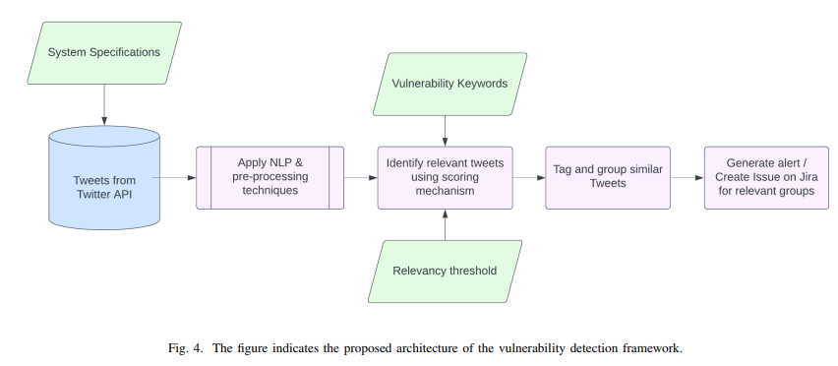
Methodology
The study involves collecting data from Twitter using the Twitter Developer API.
38 software products were randomly selected, and relevant tweets were gathered, cleaned, and labeled by human annotators.
A classification process was applied, and the results were compared with human annotations to calculate accuracy, precision, and recall.

Slide 7
Results
An accuracy score of 0.87, precision score of 0.60, and recall score of 0.75 were obtained.
Rigorous curation of the vulnerability keyword dataset contributed to high accuracy.

Slide 8
Limitations
Existing approaches based on predefined accounts may be affected by hacked accounts.
Lack of consideration for polarity checking, user feedback, and quality improvement techniques.
Limited application of keyword extraction techniques in the field.

Slide 9
Future Work
The developed application can be extended to provide alerts for fixes or updates released.
Inclusion of other sources like security blogs and social network platforms for more comprehensive analysis.

Slide 10
Conclusion
The paper presents a framework for proactively securing software by analyzing Twitter data for vulnerability alerts.
The evaluation demonstrates high accuracy, precision, and recall.
Future enhancements could involve broader data sources and improved keyword identification for even better results.

Slide 11
Thank You

